Slide 1
Infinite Campus 101
How to Download and Navigate Infinite Campus

Slide 2
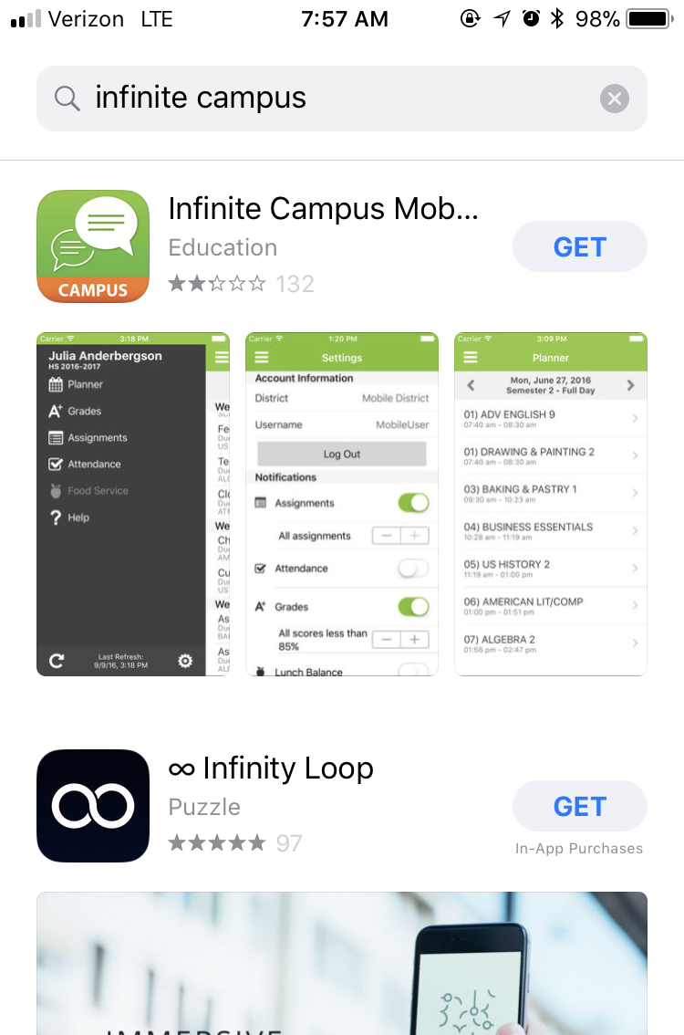
DOWNLOADING INFINITE CAMPUS ON YOUR SMART PHONE
Go to the App Store
Search for Infinite Campus
Click “GET”

Slide 3
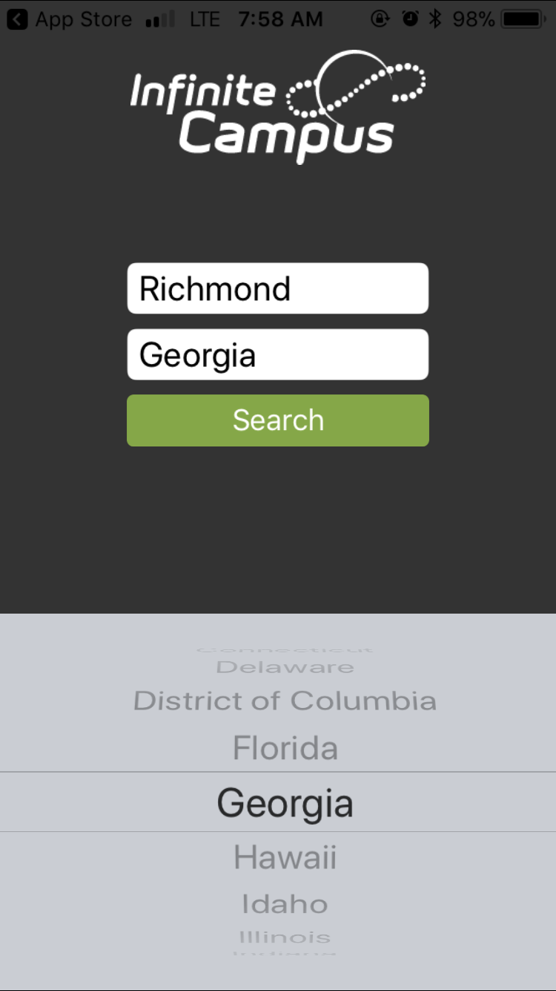
1. Where it asks for District Name, type in Richmond
2. Select Georgia for State
3. Click “Search”

Slide 4
Select Richmond County School System

Slide 5
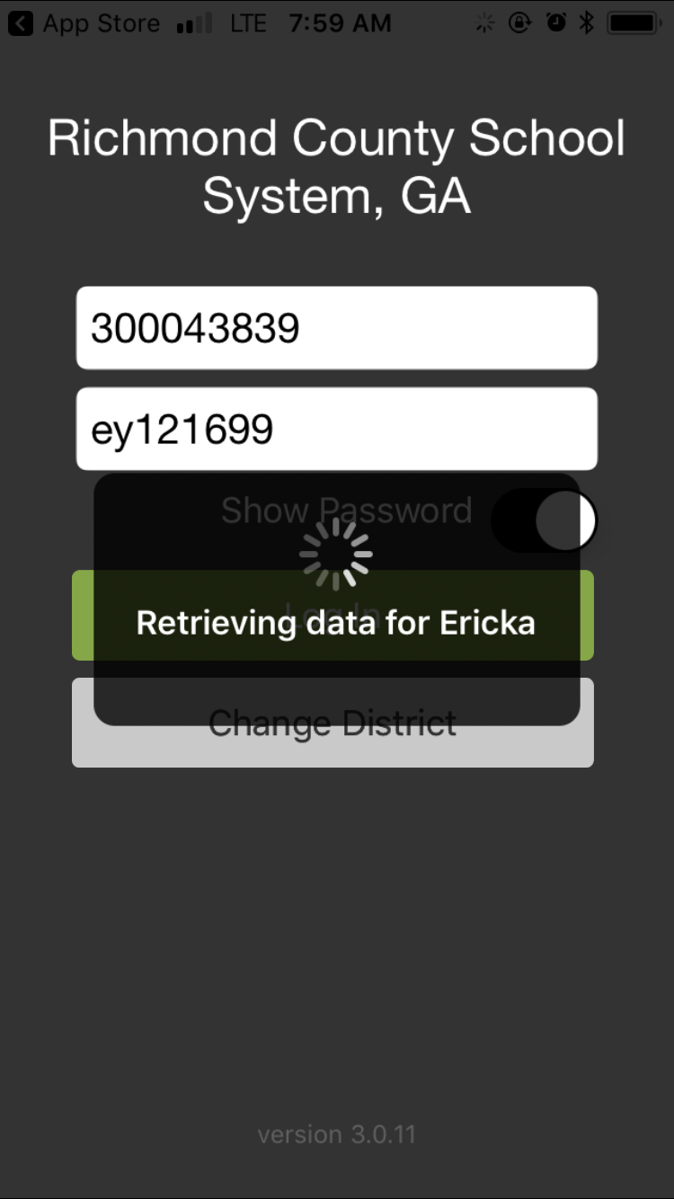
Username: your 3000#
(located on any report
card, progress report etc.)
300012345
Password: first initial, last initial, 6 digit birthdate
Example:
Name: John Doe
DOB: 10/17/2002
jd101702

Slide 6
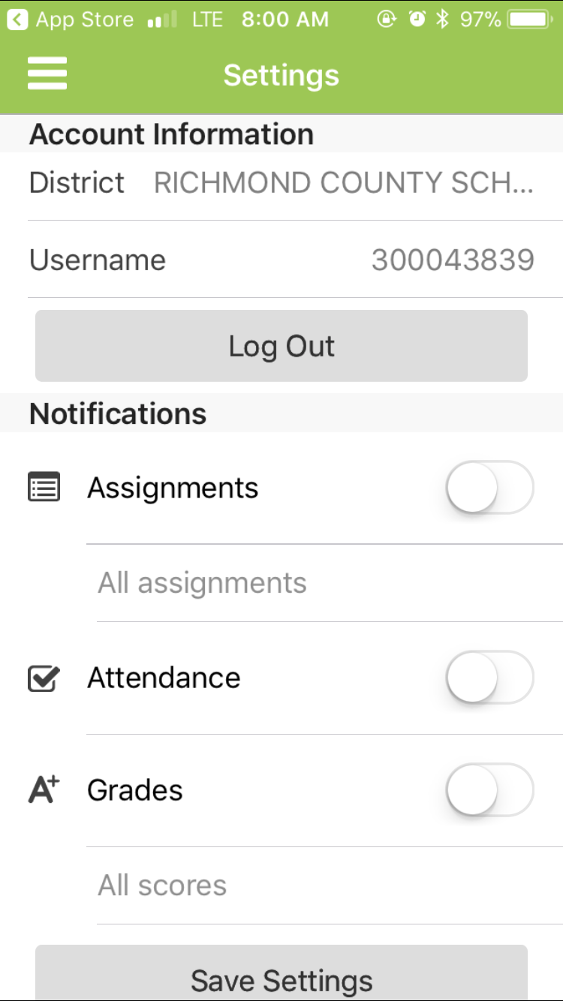
This is what you will see once you
log in.
Under notifications is where you can
set it to make sure you get alerts
about assignments, grades, and
attendance.

Slide 7
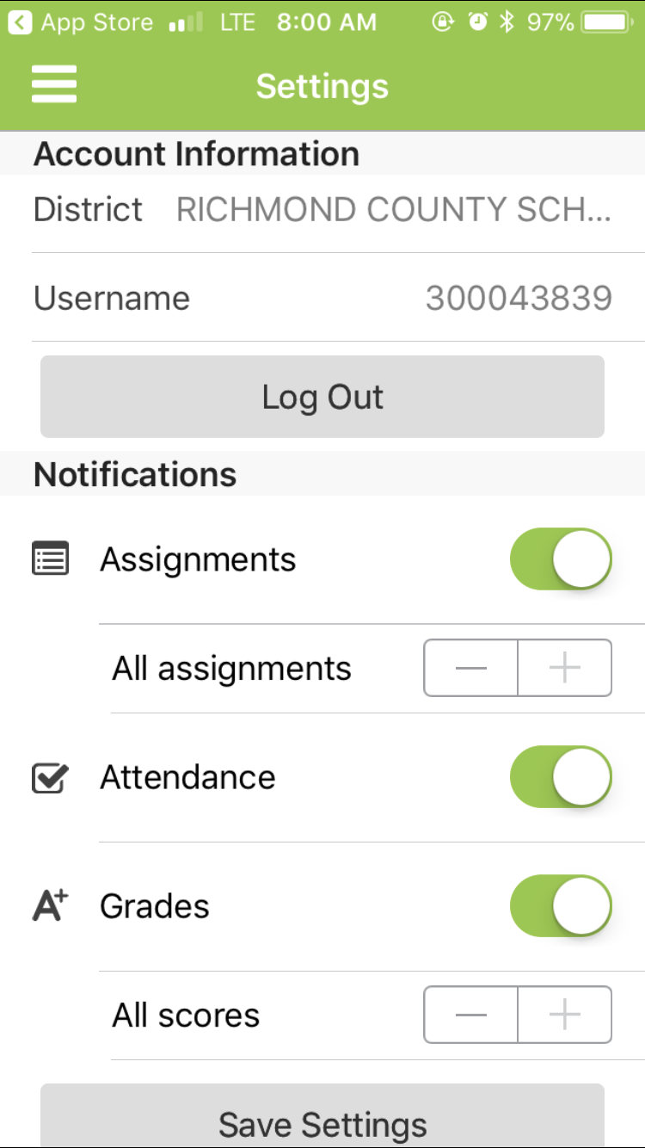
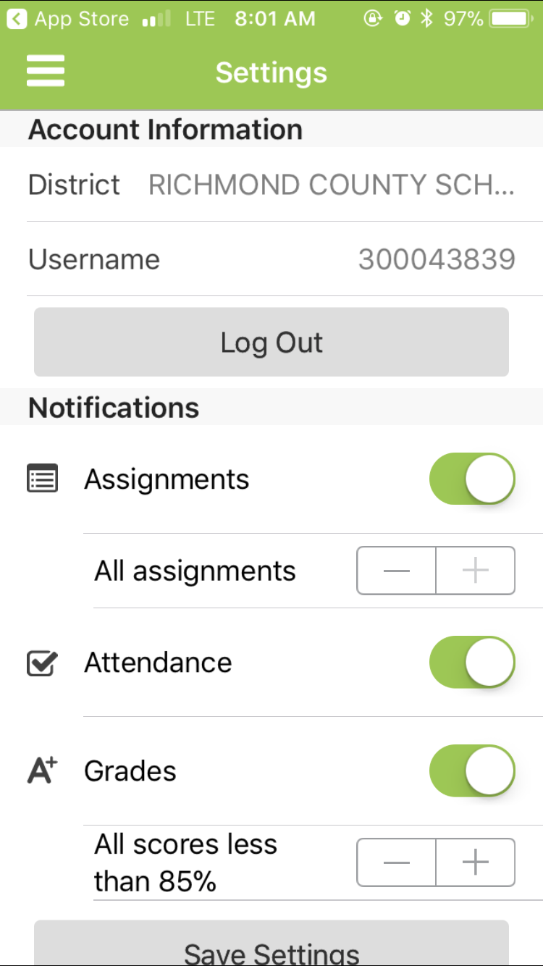
Touch the circles to turn on
your notifications
You can alter your settings to only receive notifications for grades under a certain percentage, or you can set it to receive notifications for all grades

Slide 8
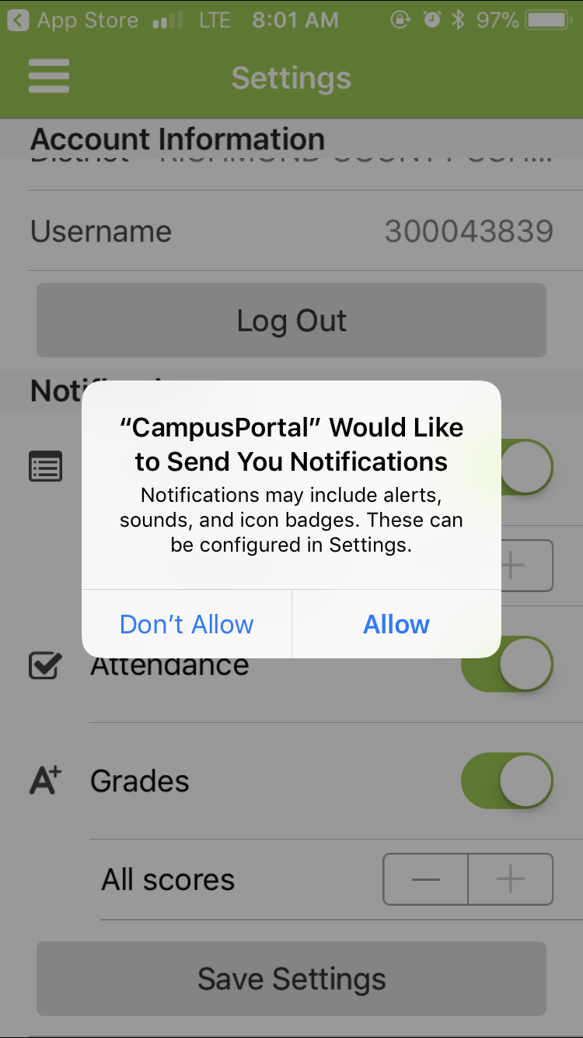
You must click “Allow” to receive the notifications

Slide 9
The icon in the top left corner with 3 lines is your menu.

Slide 10
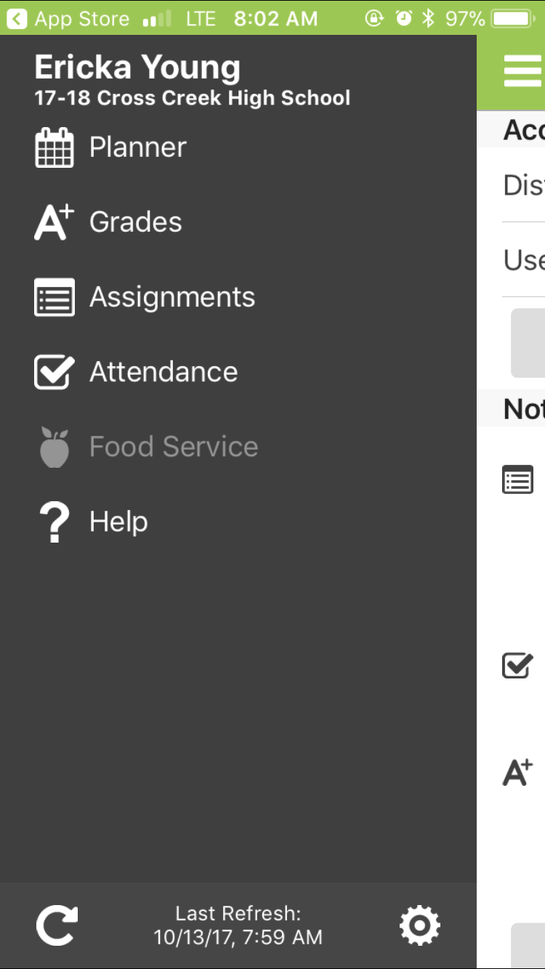
Click on Planner to see your courses.

Slide 11
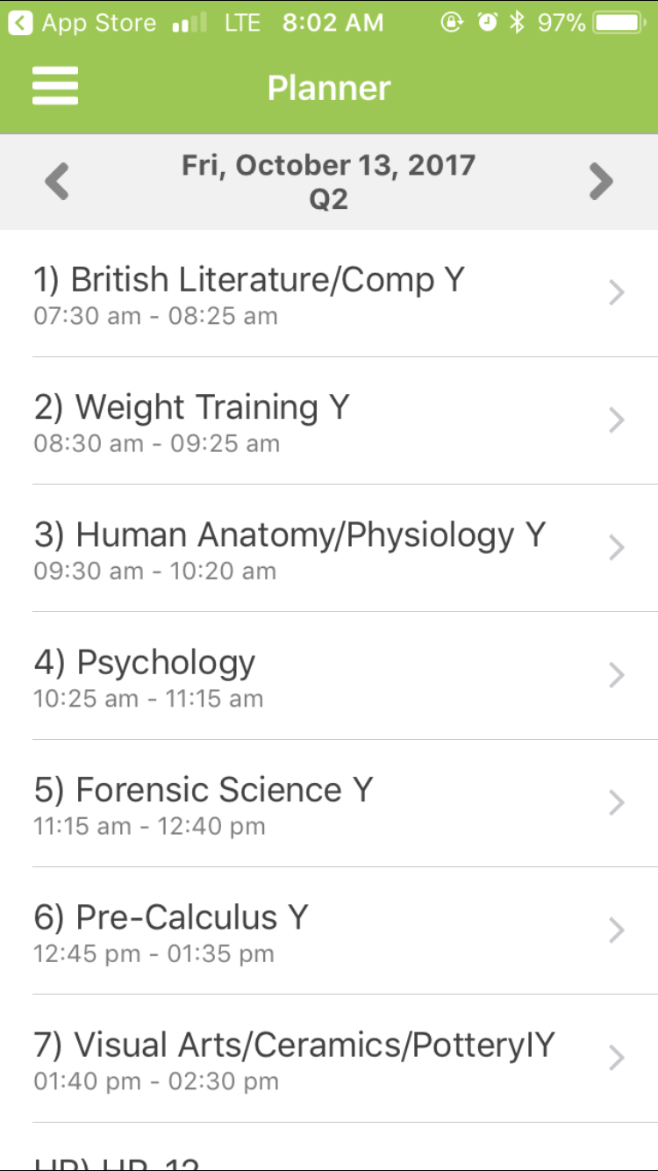
Click on a class to see details about grades, assignments, etc.

Slide 12
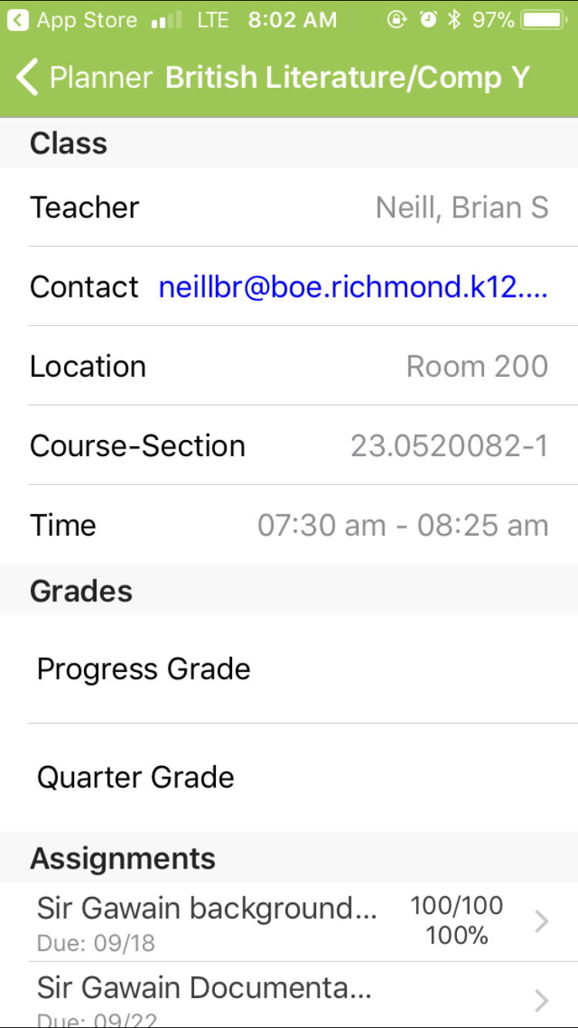
Here you can see:
Teacher’s email
Room #
Class Time
Assignments
Grades

Slide 13
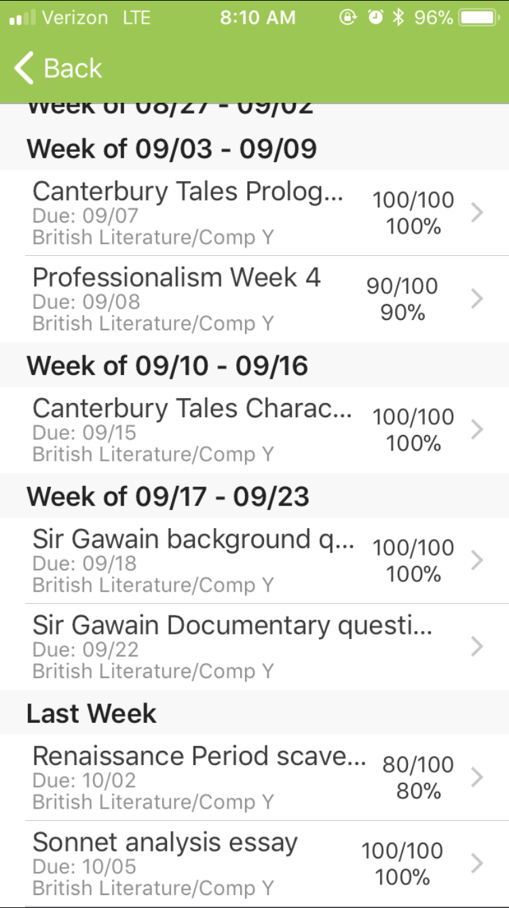
Scroll down to see more assignments and grades

Slide 14
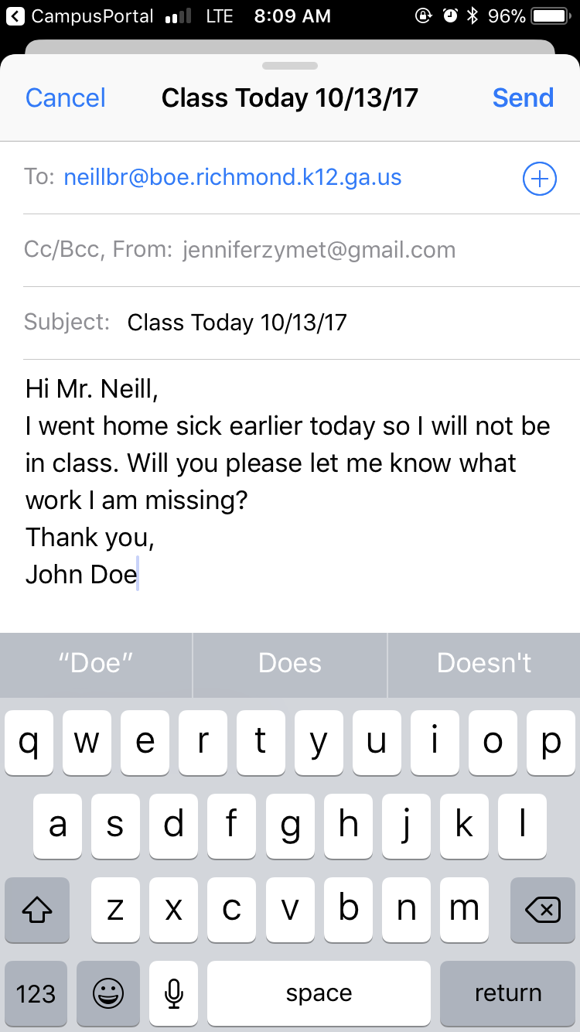
Need to contact your teacher? Click on the email hyperlink to send them a message.

Slide 15
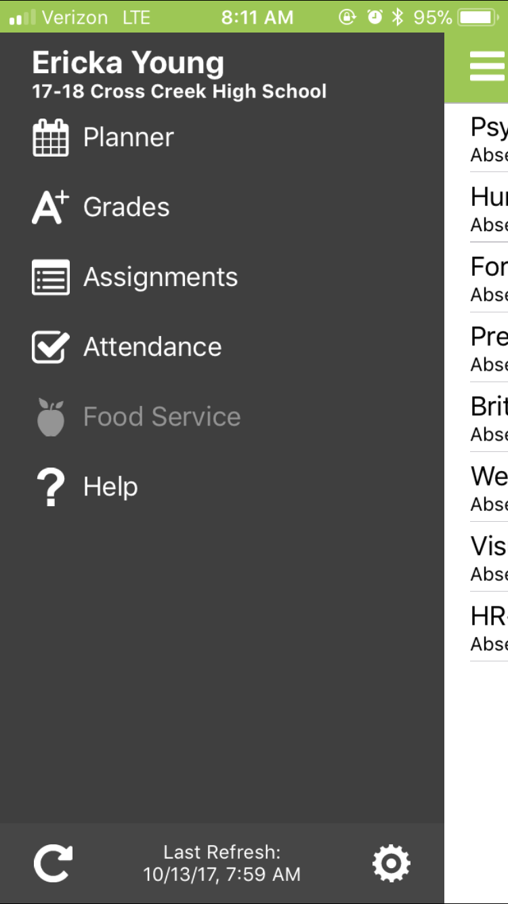
Go back to the menu button to see details on your attendance

Slide 16
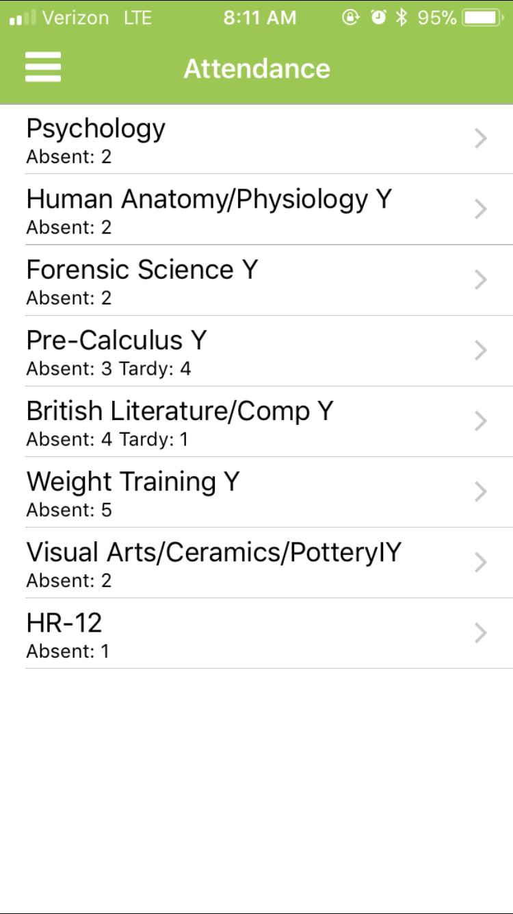
Select a class

Slide 17
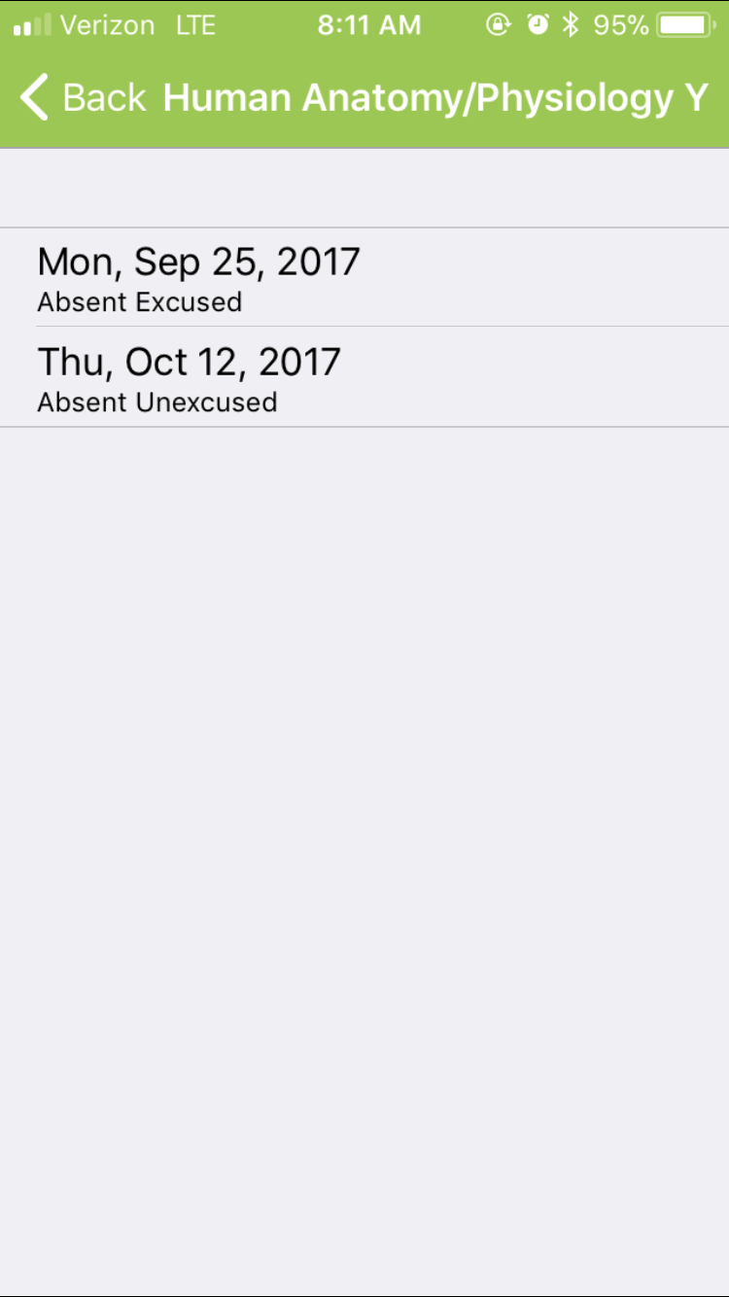
See attendance details

Slide 18
When you use Infinite Campus regularly, there are no surprises about your grades. You will always know how you are doing in your classes.
Don’t have it yet? Download it now.
That is all for Infinite Campus 101 !

